Slide 1
Accelerating Therapeutic Opportunities for Medicine
Notes:
ATOM is a new public-private partnership that integrates high-performance computing, diverse data, and emerging biotechnologies to create a new platform for drug discovery.

Slide 2
Health Threats Emerge Faster Than Our Ability to Address Them
Molecular interventions to address emergent and known threats lag the need for them by years: bio-threats, cancer, neurodegenerative disease
The current approach to drug discovery is sequential, linear and empirically iterative.
…Why?
Can we accelerate the process to discover new medicines in weeks, not years?
Notes:
Current drug discovery follows a mostly linear, sequential, staged approach, that balances cost and risk.
Millions screened, 1000s made/tested – most fail

Slide 3
The goal of ATOM is to accelerate and democratize drug discovery and optimization
We’ll do this by ….
Demonstrating acceleration and effectiveness of AI and computing-driven molecular discovery and optimization
Developing, validating, and releasing an open platform for molecular discovery and design
Applying the platform to making molecules for work on cancer, infectious disease, and underserved needs in the public good
Notes:
Initially we will be simply assign a score for each molecule from the virtual screen and rank them.
Next will be a stretch goal – and dependent on resources (e.g. people, time and priorities).
Will need to train autoencoder on ~100K molecules predicted to be best from our initial virtual screen. (potentially do-able, from Kevin or possibly Derek)
Will need to be able to call ConveyorLC from the design loop. (extra effort)

Slide 4
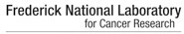






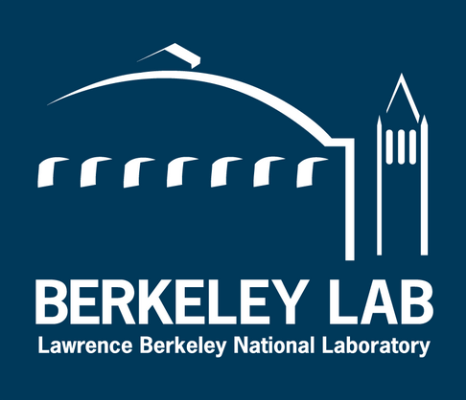






The ATOM Public-private Consortium Experiment: Can independent government entities and private industry work together to expedite drug discovery?
Founding Organizations
October, 2017
Experimental biology, data analytics, open data and models
Cancer biology and new assay development
High performance computing, data science, and molecular design
Drug discovery, chemistry, and historical dark data
Founding Vision
Academic
Subsequent R&D Collaborations and Partners
Cancer Centers
High-performance computing
Pharma
Tech
Gov’t Labs
ATOM CRADA
Partners
Notes:
Small Molecules
Cancer target first
Mention that GSK is funding ATOM Fellows in year 4

Slide 5
The ATOM molecular design process integrates predictive models, multi-parameter optimization, and active learning
ATOM products
Molecular data library - Open curated and model-ready database
AMPL - Predictive modeling platforms - training, optimization, and property prediction
LBANN – Computing platform for generative molecular models
GMD - A high-performance platform for parallel optimization of efficacy, safety, and pharmacokinetics
Pilot design projects in cancer, infectious disease and other areas
AMPL – ATOM Modeling PlpeLine
LBANN – Livermore Big Artificial Neural Network
GMD – Generative Molecular Design
Notes:
Initially we will be simply assign a score for each molecule from the virtual screen and rank them.
Next will be a stretch goal – and dependent on resources (e.g. people, time and priorities).
Will need to train autoencoder on ~100K molecules predicted to be best from our initial virtual screen. (potentially do-able, from Kevin or possibly Derek)
Will need to be able to call ConveyorLC from the design loop. (extra effort)

